Slide 1


DEPI Graduation Project
ROUND : CAI4_AIS4_G2
GROUP : 1
Customer Churn Analysis in Telco Industry
Team
Team
Team
Team
Team

Slide 2
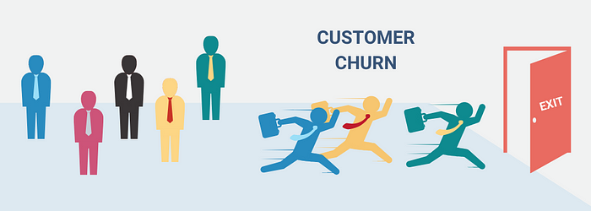

Slide 3

Agenda
1
Introduction
2
Milestone 1 :
Data Collection, Exploration, and Preprocessing
3
Milestone 2 :
Advanced Data Analysis and Feature Engineering
4

Slide 4

Introduction
1
2
3
4
Introduction
Milestone 1
Milestone 2
Milestone 3

Slide 5
What is Customer Churn?
Customer churn, also known as customer attrition, refers to the departure of customers or subscribers for any reason. Businesses monitor churn by calculating the percentage of lost customers relative to the total customer base within a specific timeframe. This metric is typically measured on a monthly basis and reported at the end of each month.
# of churned customers over a given period
Customer Churn Rate =
X
100
Total # of customers at the beginning o the period

Slide 6
Project Overview
Business Problem
Customer churn causes revenue loss and increased acquisition costs.
Telecom companies need to identify customers likely to leave to take proactive retention measures.
Project Objective
Building a machine learning model – utilizing data science techniques such as data collection, exploration, feature engineering, machine learning, etc. – to predict customer churn.
Dataset Overview
Telco Customer Churn Dataset
7,043 customer records
Includes:
Customer demographics
Service subscriptions
Contract information
Billing details
Churn status
Dataset URL: https://www.kaggle.com/datasets/hossamfarhoud/wa-fn-usec-telco-customer-churn

Slide 7
Data Collection, Exploration, and Preprocessing
1
2
3
4
Introduction
Milestone 1
Milestone 2
Milestone 3

Slide 8
Milestone 1 : Data Collection, Exploration, and Preprocessing
Exploratory Data Analysis (EDA)
Missing value analysis
Duplicate detection
Numerical and categorical analysis
Distribution analysis
Data Cleaning
Converted some data types to numeric format
Handled missing values
Standardized inconsistent categories
Checked outliers and data consistency
Visualizations Used
Bar Charts
Pie Charts
Histograms
Boxplots

Slide 9
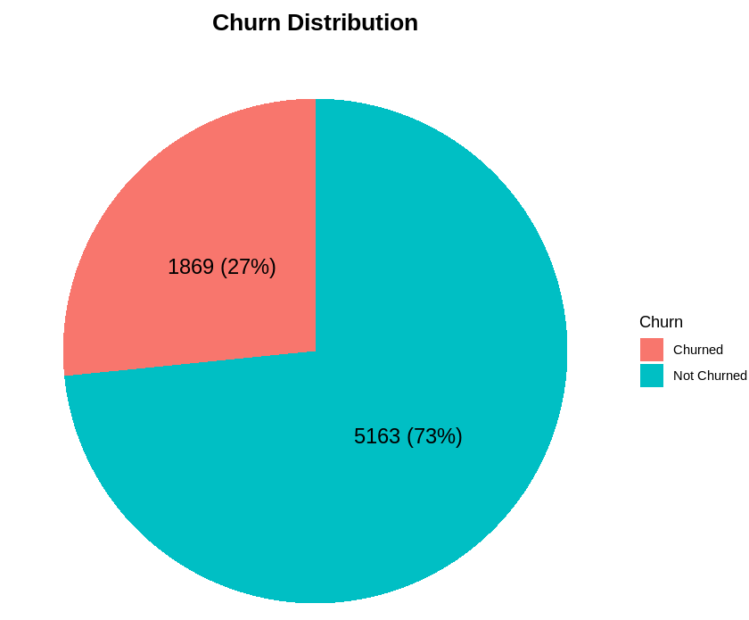
Churn Analysis
Key Insights:
A significant majority (73%) of the customers have not churned, indicating a relatively high retention rate.
While the majority of customers are retained, the 27% churn rate represents a substantial portion that could impact business performance. Understanding the reasons behind this churn is important for improving retention strategies.

Slide 10
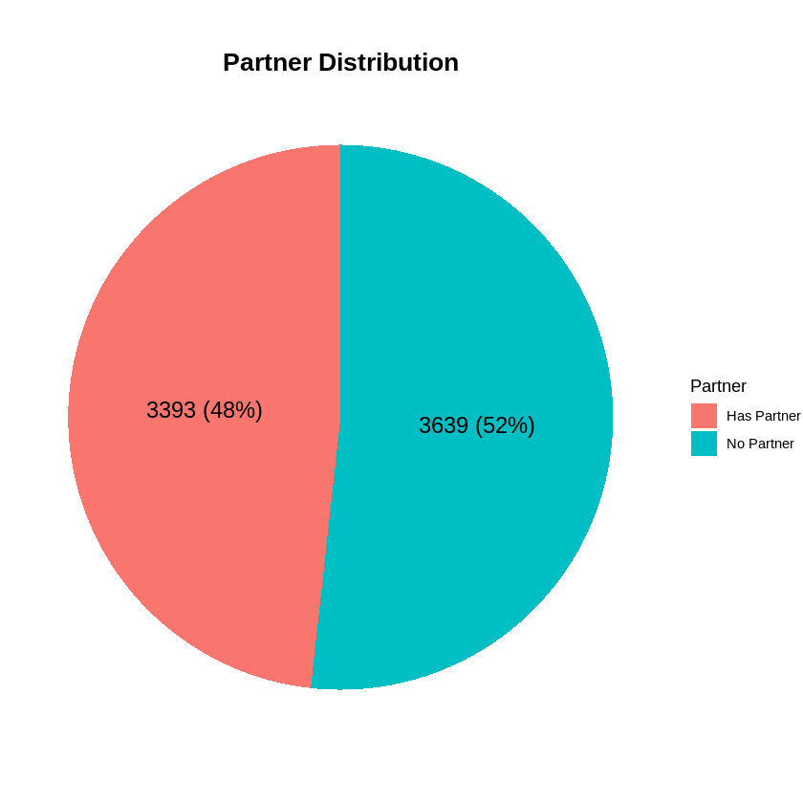
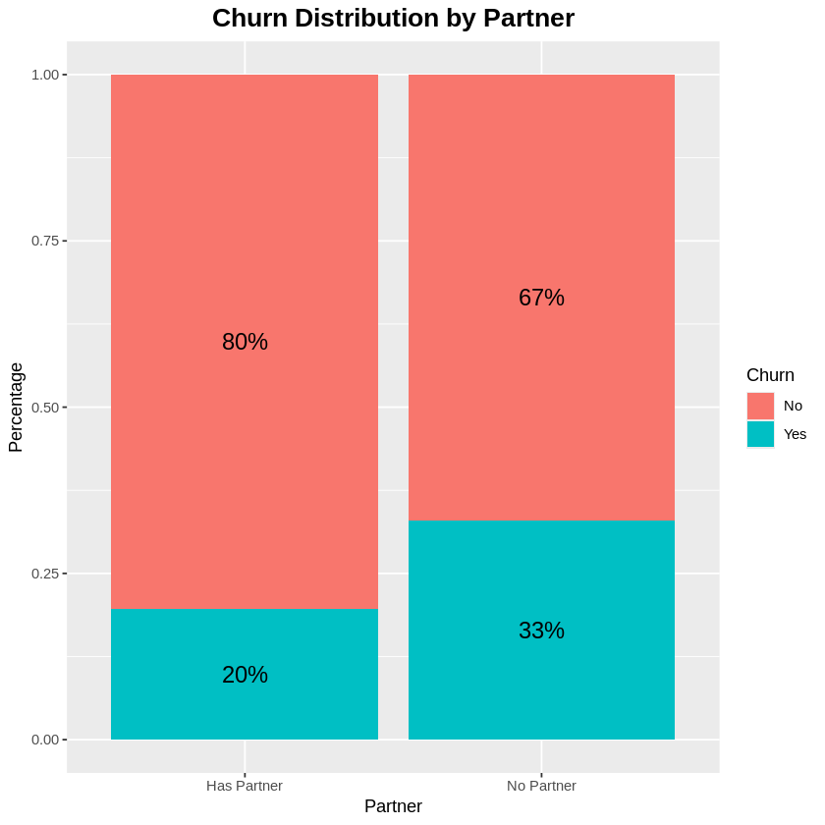
Partner Analysis
Key Insights:
The distribution is nearly even, with 48% (3,393) having a partner and 52% (3,639) not having a partner. This indicates a relatively balanced representation of customers with and without partners in the dataset.
customers without a partner have a significantly higher churn rate (33%) compared to those with a partner (20%).

Slide 11
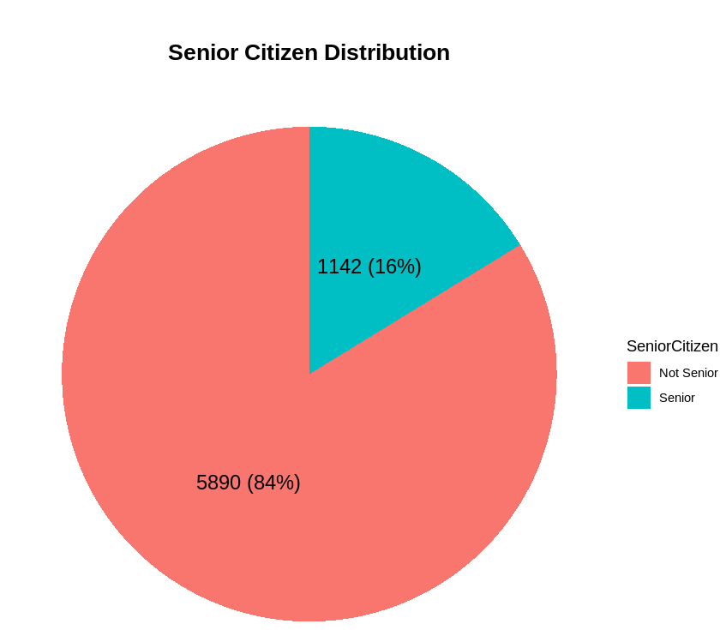
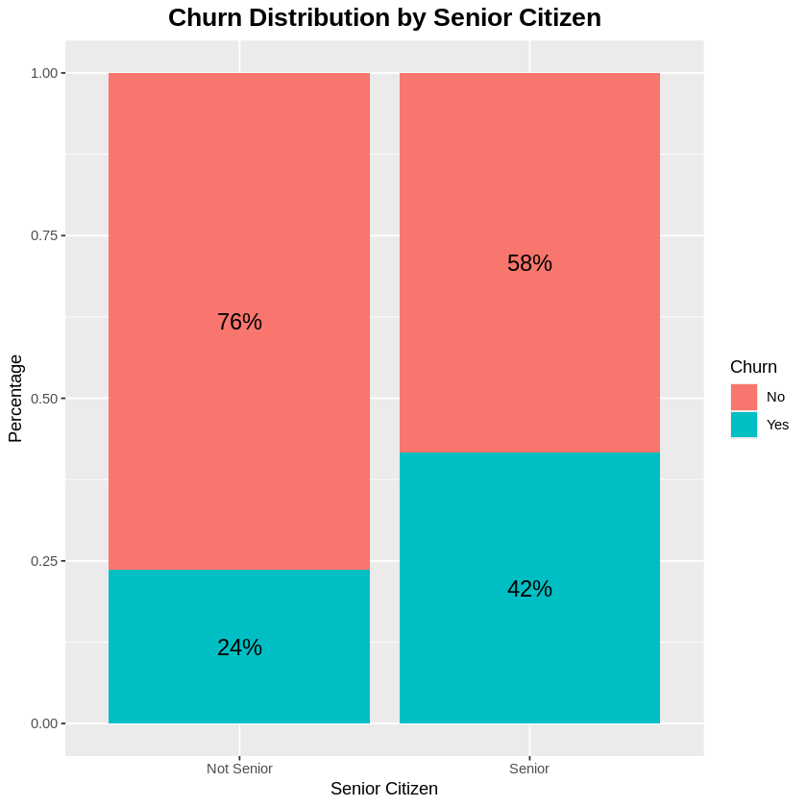
Senior Citizen Analysis
Key Insights:
The distribution is heavily skewed towards non-senior citizens, indicating that senior citizens are a minority in this population.
customers who are senior citizens have a significantly higher churn rate (42%) compared to those who are non-senior (24%).

Slide 12
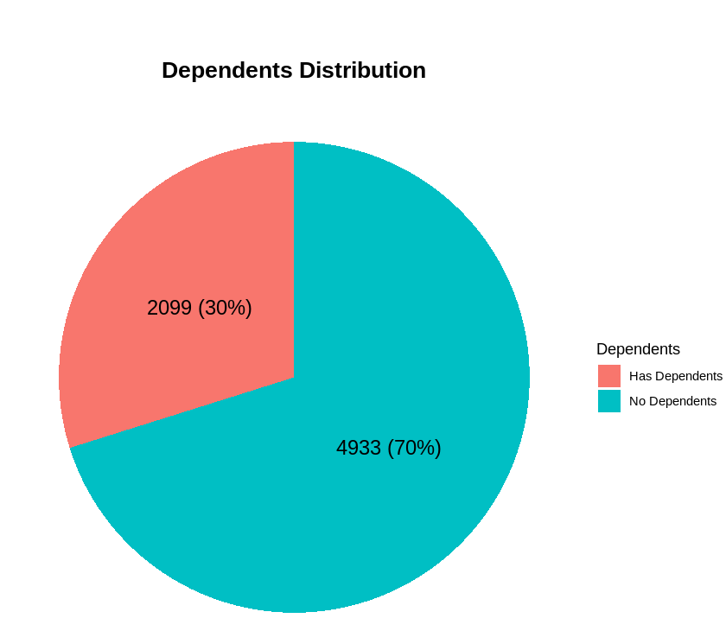
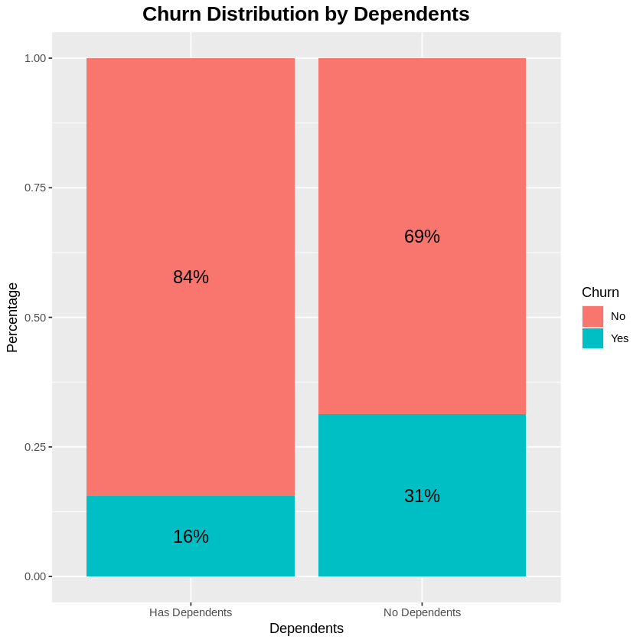
Dependents Analysis
Key Insights:
The dataset is heavily skewed towards customers without dependents, indicating that those with dependents are a minority in this population.
customers without dependents have a significantly higher churn rate (31%) compared to those with dependents (16%).

Slide 13
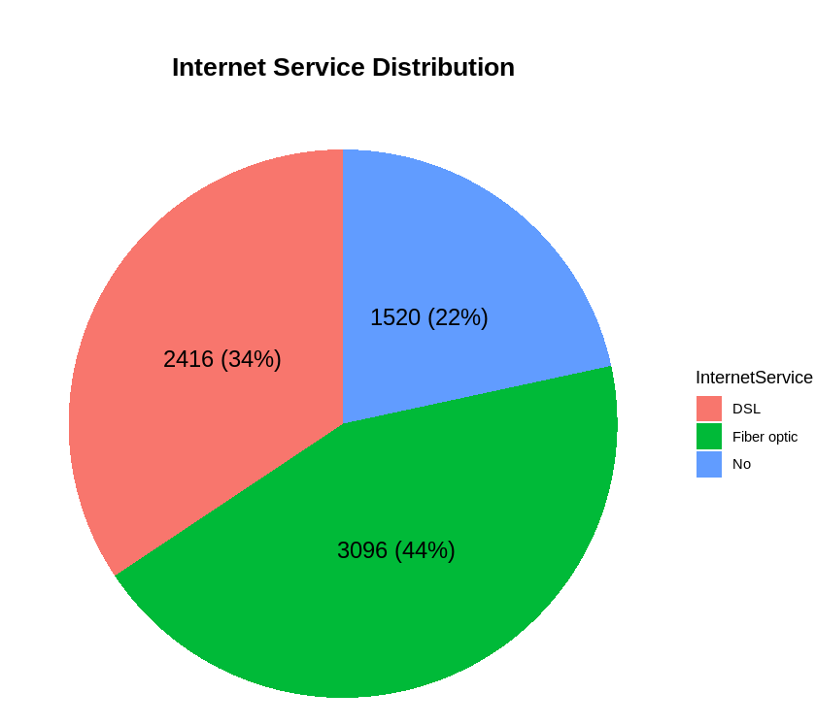
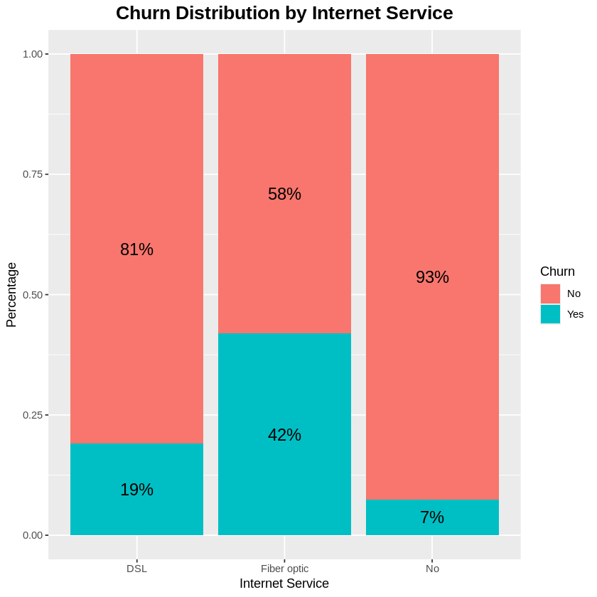
Internet Service Analysis
Key Insights:
A significant portion (44%) of the customers have Fiber Optic internet service, making them the largest group in the dataset.
Fiber optic users have the highest churn rate (42%), significantly higher than DSL users (19%).

Slide 14
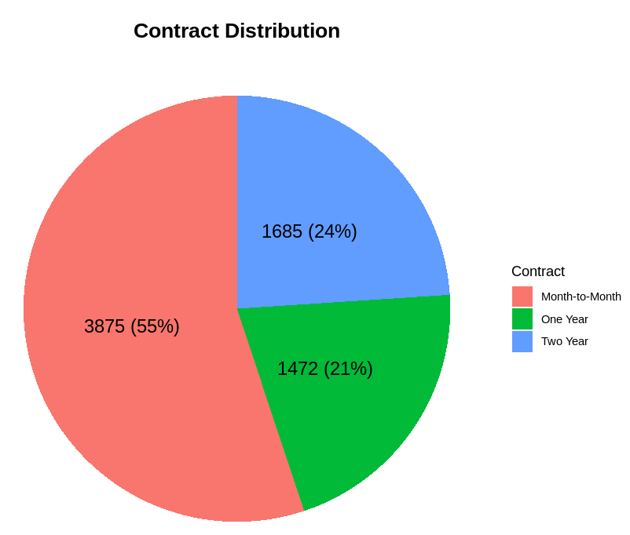
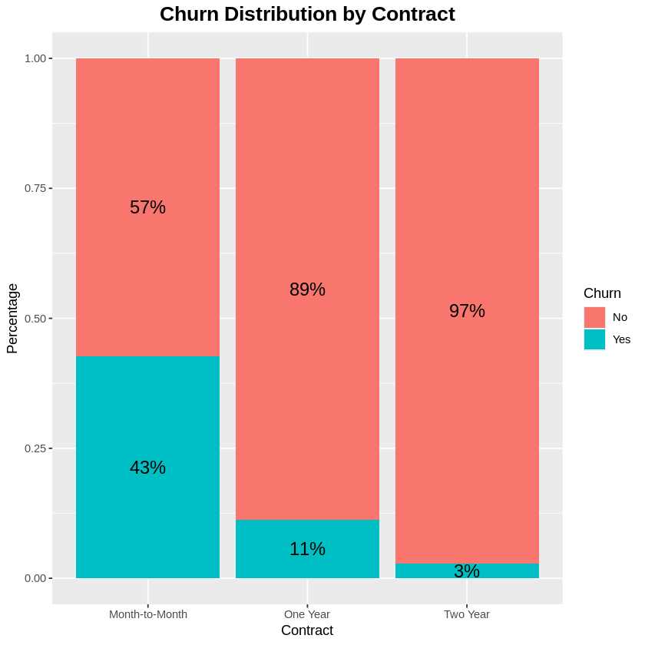
Contract Analysis
Key Insights:
A significant majority (55%) of the customers have month-to-month contracts, indicating a preference for short-term commitments.
customers with month-to-month contracts have a significantly higher churn rate (43%) compared to those with one-year (11%) and two-year contracts (3%).

Slide 15
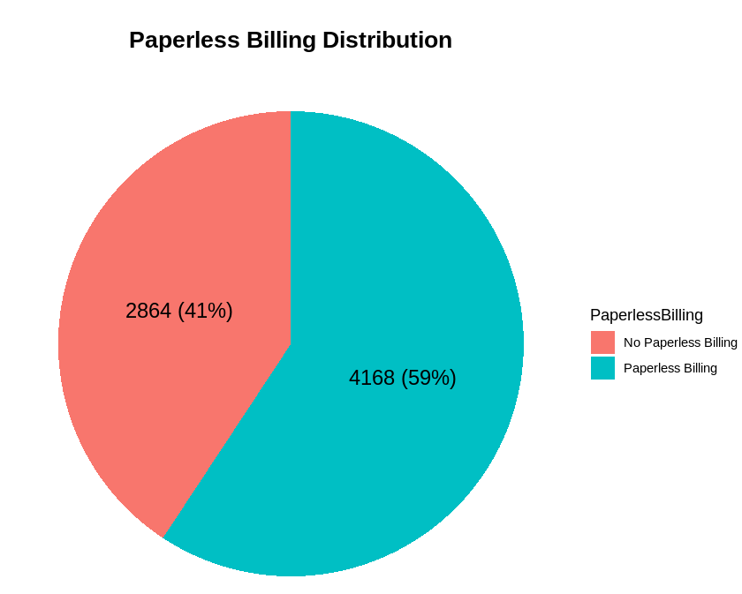
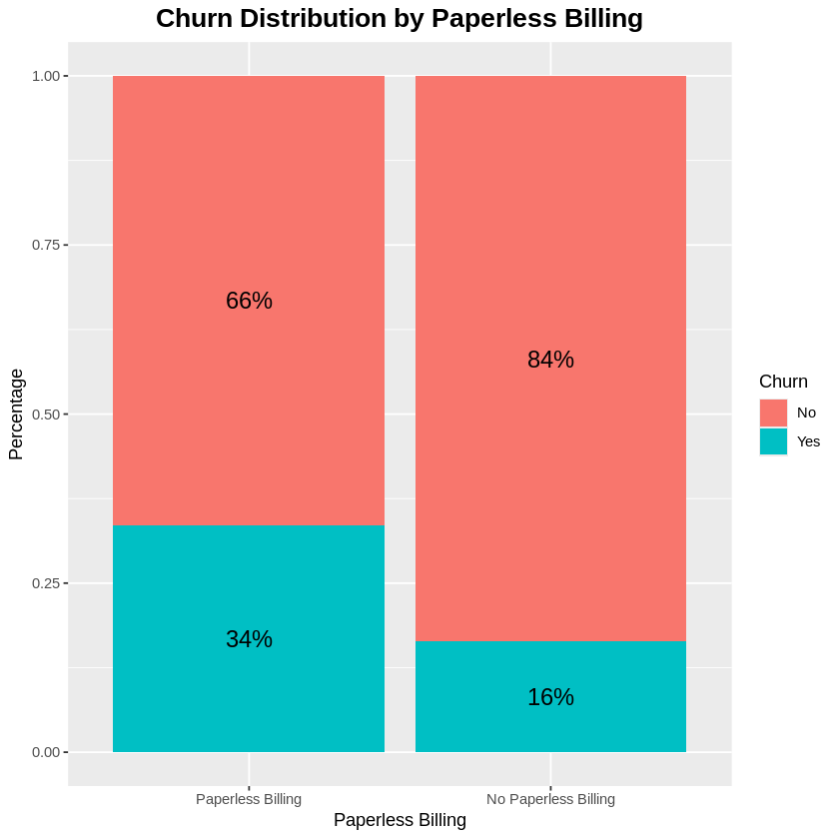
Paperless Billing Analysis
Key Insights:
A significant majority (59%) of the customers use paperless billing, indicating a preference for digital billing methods.
customers using paperless billing have a significantly higher churn rate (34%) compared to those not using paperless billing (16%).

Slide 16
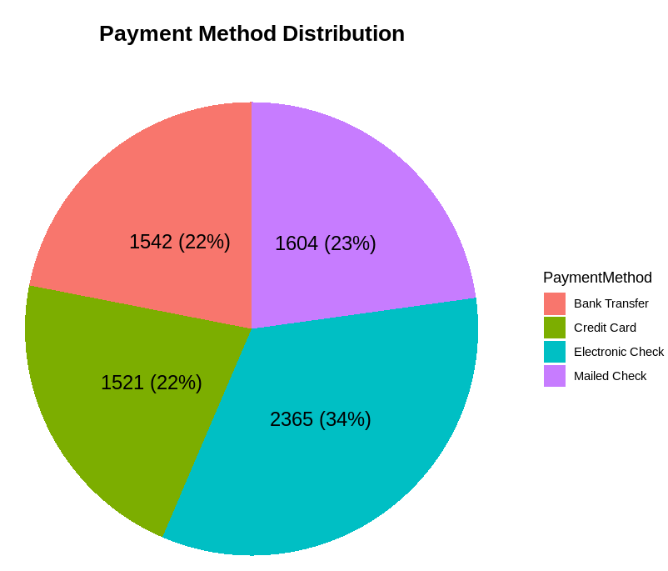
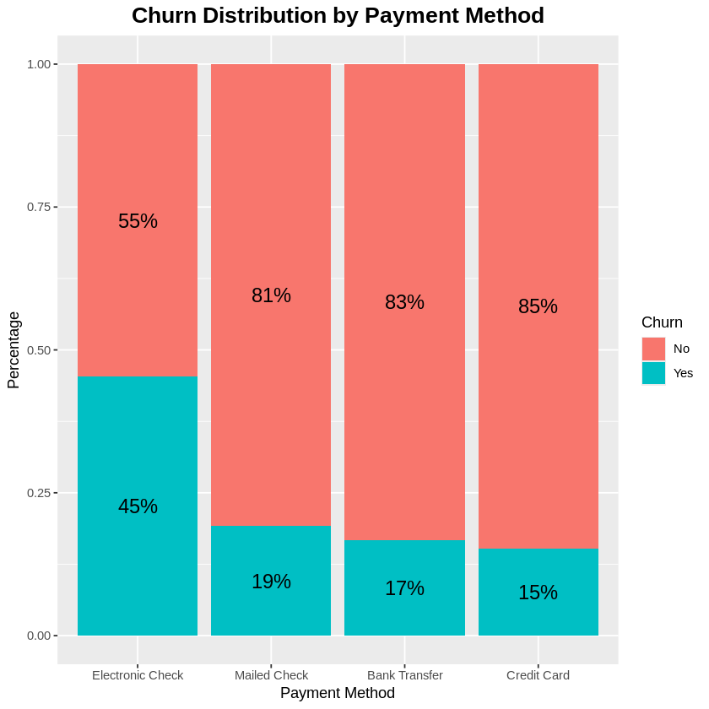
Payment Method Analysis
Key Insights:
Electronic check is the most commonly used payment method (34%), followed closely by mailed check (23%), bank transfer (22%), and credit card (22%).
customers using electronic checks have a significantly higher churn rate (45%) compared to those using other payment methods.

Slide 17
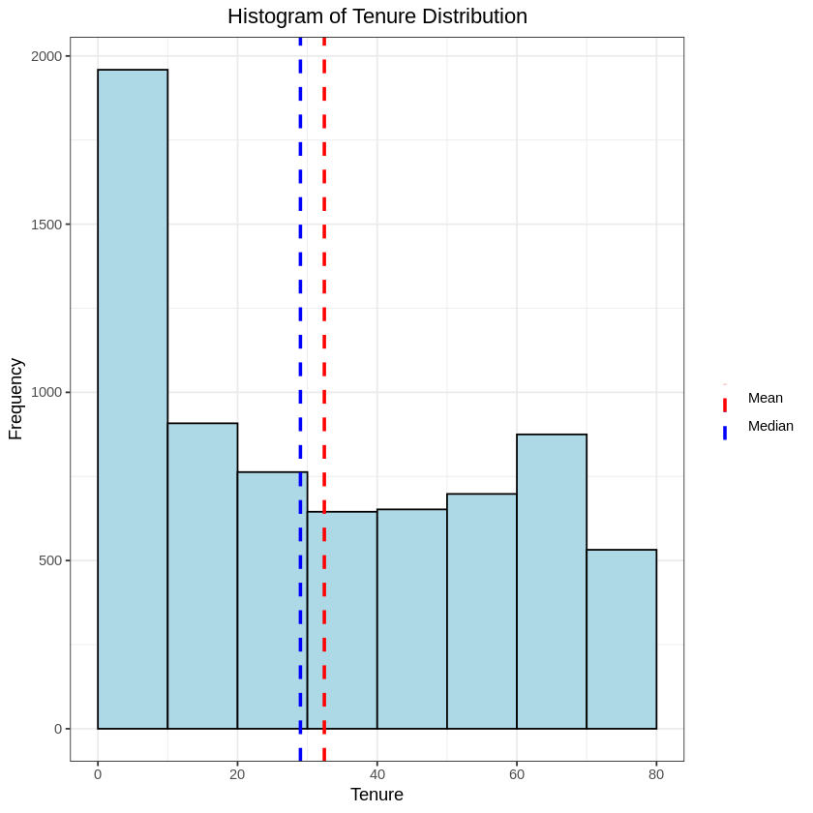
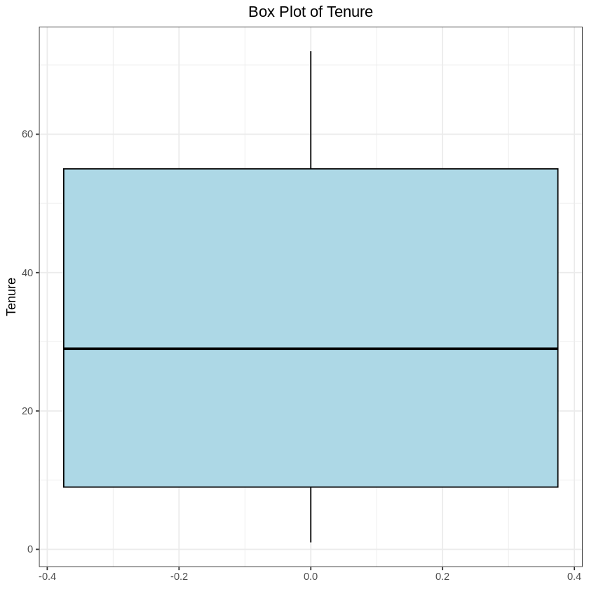
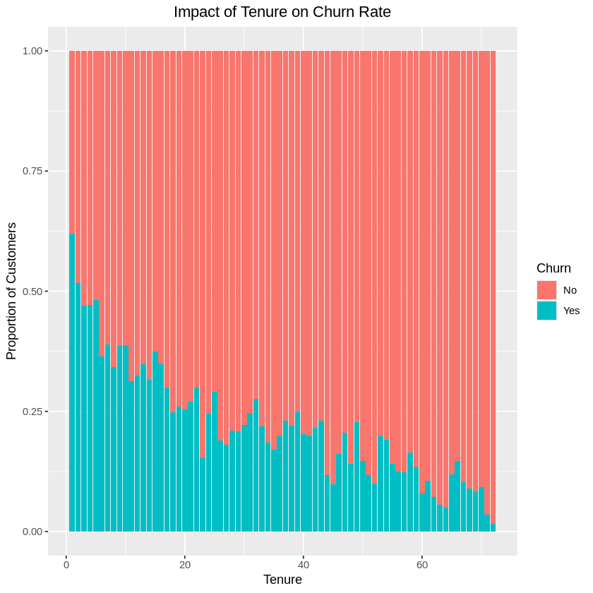
Tenture Analysis
Key Insights:
Customers with shorter tenures are more likely to churn, as indicated by a higher proportion of "Yes" in the churn category.
Customers with longer tenures are less likely to churn, as indicated by a higher proportion of "No" in the churn category.

Slide 18
Advanced Data Analysis and Feature Engineering
1
2
3
4
Introduction
Milestone 1
Milestone 2
Milestone 3

Slide 19
Milestone 2 : Advanced Data Analysis and Feature Engineering
Statistical Tests Performed
T-Tests Applied on:
tenure
MonthlyCharges
TotalCharges
Result:
Significant differences between churned and retained customers.
Chi-Squared Tests Applied on:
Contract type
Payment method
Internet service
Tech support
Online security
Result:
Strong statistical relationship with churn.

Slide 20
Milestone 2 : Advanced Data Analysis and Feature Engineering
New Engineered Features
Created:
Average Monthly Spending
Total Services
Charge Per Service
Long-Term Customer Flag
Tenure Groups
Data Preparation for ML
One-hot encoding for categorical variables
MinMaxScaler normalization
Feature selection using:
Random Forest
RFE (Recursive Feature Elimination)
Outcome
Fully machine-learning-ready dataset
Top 15 most significant features selected

Slide 21
MILESTONE #3
Objectives:
• Build, train, and optimize machine learning models to predict churn.
Deliverables:
• Model Evaluation Report: A detailed report comparing model performance with evaluation metrics.
• Model Code: Python code used to train, optimize, and evaluate the models.
• Final Model: The best-performing churn prediction model, tuned and ready for deployment

Slide 22
MILESTONE #4
Milestone 4: MLOps, Deployment, and Monitoring
Objectives:
• Implement MLOps practices and deploy the churn prediction model for real-time or batch predictions.
Deliverables:
• Deployed Model: A fully functional API or cloud-deployed model that can make real-time churn predictions.
• MLOps Report: A report detailing the MLOps pipeline, experiment tracking, model deployment, and monitoring setup.
• Monitoring Setup: Documentation on how to track model performance and trigger updates or retraining

Slide 23
MILESTONE #5
Milestone 5: Final Documentation and Presentation
Objectives:
• Prepare final documentation and create a presentation for stakeholders that showcases the project's results and business impact.
Deliverables:
• Final Project Report: A detailed summary of the project’s process, from data collection to deployment, and the business impact of churn prediction.
• Final Presentation: A polished presentation for business stakeholders, explaining the model’s value and usage

Slide 24
Conclusion & Recommendations
1
2
3
4
Conclusion &
Recommendations

Slide 25
Conclusion & Recommendations
# | Conclusion | Recommendation
1 | The churn rates between males and females are nearly identical, suggesting that gender may not be a significant factor influencing churn in this dataset. | Retention strategies should target both genders with the same interest.
2 | The presence of a partner appears to be associated with higher customer retention. | Targeted retention strategies for customers without partners could help reduce overall churn rates.
3 | The presence of dependents appears to be associated with higher customer retention. | Targeted retention strategies for customers without dependents could help reduce overall churn rates.
4 | The presence of phone service (regardless of multiple or single lines) is associated with slightly better retention compared to those without phone service. | The marketing team should implement new campaigns to encourage customers to get phone services and to encourage other customers to get multiples lines.
5 | The type of internet service significantly impacts churn behavior, with fiber optic customers being more likely to churn. | Implement targeted retention strategies for fiber optic customers. Improve service quality for fiber optic customers to reduce dissatisfaction.
6 | Only 29% of the customers have online security, indicating a relatively low adoption rate among those with internet service. | This suggests a need for increased awareness or incentives to adopt security measures among internet customers.

Slide 26
Conclusion & Recommendations
# | Conclusion | Recommendation
7 | Customers with online security exhibit a lower churn rate (15%), indicating better retention compared to Customers without online security. | This suggests that enhancing online security measures could improve customer retention.
8 | The low adoption of online backup suggests potential risks and a need for increased awareness or incentives to adopt backup solutions among internet users. | This suggests that promoting online backup solutions could improve customer retention.
9 | The low adoption of device protection suggests potential risks and a need for increased awareness or incentives to adopt protection. | This suggests that promoting device protection solutions could improve customer retention.
10 | The low adoption of tech support suggests potential challenges and a need for increased awareness or incentives to adopt tech support services among internet users. | We recommend promoting tech support services for customers as it could significantly improve customer retention.
11 | The presence of streaming movies is associated with slightly lower churn rates. | We recommend adjusting new pricing models for streaming movies services.

Slide 27
Conclusion & Recommendations
# | Conclusion | Recommendation
12 | The high prevalence of month-to-month contracts suggests a need to focus on retention strategies for this group, as they may be more likely to churn compared to those with longer-term contracts. | We recommend encouraging customers to switch to longer-term contracts as it could significantly reduce churn rates and improve customer retention.
13 | The high adoption of paperless billing suggests that digital communication channels are widely accepted and could be leveraged for further customer engagement and retention strategies. | We recommend migrating paper billing services to be paperless to maintain the same experience for the majority of customers.
14 | The relationship between tenure and churn rate highlights the importance of customer retention strategies, particularly for newer customers. | Investigate the reasons behind higher churn rates among customers with shorter tenures (e.g., onboarding process, initial customer experience). Develop loyalty programs and engagement strategies to improve retention for newer customers. Encourage longer contract commitments by offering discounts or loyalty benefits.

Slide 28
Conclusion & Recommendations
# | Conclusion | Recommendation
15 | The diversity in payment methods suggests that customers have varied preferences, and understanding these preferences can help in tailoring payment-related services and communications. | Provide incentives for electronic check users to switch to more stable payment methods.
16 | There are higher churn rates among customers with no value-added services (security, backup, tech support) compared to other customers with such services. | Promote value-added services (security, backup, tech support) to increase retention.

Slide 29
Action Plan
1
2
3
4

Slide 30
Action Plan to Improve Customer Churn Rates
Objective:
Reduce customer churn by identifying key drivers, improving customer experience, and increasing retention through data-driven strategies.
Improve Customer Satisfaction & Engagement
Optimize Pricing & Service Offerings
Strengthen Retention Strategies
Enhance Customer Onboarding
Improve Service Quality & Offer Additional Value
Leverage Data & Predictive Analytics
Actions

Slide 31
Actions
1. Improve Customer Satisfaction & Engagement
Action Steps:
Conduct customer satisfaction surveys and analyze feedback.
Improve customer technical support responsiveness, reducing complaint resolution time.
Expected Outcome: Stronger relationships with customers, reducing dissatisfaction-driven churn.
2 Optimize Pricing & Service Offerings
Action Steps:
Create more new pricing models.
Offer discounts or loyalty programs to customers at risk of churning.
Introduce flexible contract options (e.g., month-to-month vs. long-term).
Expected Outcome: A competitive pricing strategy that retains price-sensitive customers.

Slide 32
Actions
3. Strengthen Retention Strategies
Action Steps:
Implement a proactive retention program targeting customers with high churn probability.
Launch exclusive offers for long-term customers, such as free service upgrades.
Monitor early warning signs (e.g., reduced usage, late payments) and reach out before customers leave.
Expected Outcome: Increased retention of high-value customers through proactive engagement.
4. Enhance Customer Onboarding
Action Steps:
Improve the onboarding process and make it easy with clear instructions and tutorials for new customers.
Conduct welcome calls or emails to ensure customers are fully aware of available services.
Expected Outcome: Higher initial engagement, reducing early-stage churn and increased tenure durations.

Slide 33
Actions
5. Improve Service Quality & Offer Additional Value
Action Steps:
Analyze service performance metrics (e.g., downtime, speed, quality issues).
Invest in infrastructure improvements for better reliability.
Introduce value-added services such as premium support or exclusive content.
Expected Outcome: Enhanced customer satisfaction, making customers less likely to switch to competitors.
6. Leverage Data & Predictive Analytics
Action Steps:
Continuously monitor churn trends using dashboards in Power BI or other analytics tools.
Use machine learning models to predict churn and take early action.
Expected Outcome: A data-driven approach to churn management, allowing for quick and effective interventions.

Slide 34
KEY INSIGHTS/ CONCLUSIONS
The Customer Churn Prediction and Analysis project aims to build a machine learning model that identifies customers at risk of leaving, helping businesses take action to retain them. This step-by-step process focuses on data exploration, feature engineering, model development, deployment, and continuous monitoring to ensure that the churn prediction system remains effective over time.

Slide 35
Thank You

